Slide 1
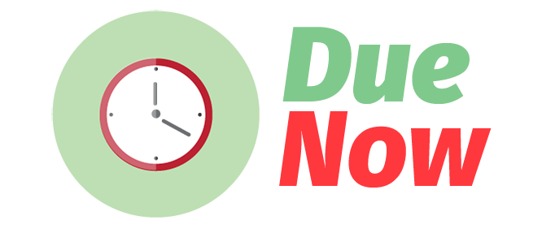
DEVELOPED BY ICEPs
Ian De La Cruz, Chiara Señires, Elysia Villadarez, Pearl Santos

Slide 2
What is Due Now?
Due Now helps you manage your time wisely by giving you suggestions on which task to finish first.

Slide 3
Features
Set priority and difficulty.
- avoid the hassle of having to constantly schedule your tasks in a certain period of time.
- define your tasks, specify each one's level of difficulty, and set whether the priority is low, medium, or high
- let the app do the categorizing and scheduling for you.

Slide 4
Features
2. Get notified of deadlines.
- Get desktop notifications whenever deadlines are near, or when there are unfinished tasks that are due soon.
3. Know when to start your tasks
- know the most efficient time to start your tasks to efficiently conquer your huge pile of tasks

Slide 5
Features
4. Get to know your work ethics
- let the app get to know you and your work ethics by looking through old records

Slide 6
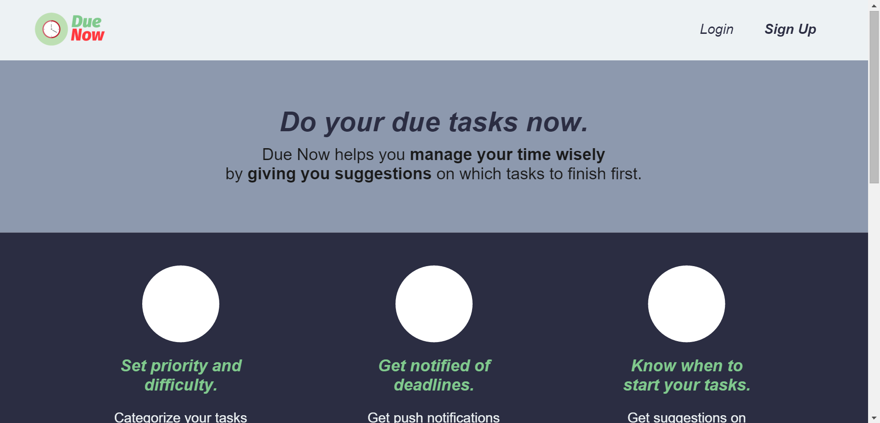
Home Screen

Slide 7
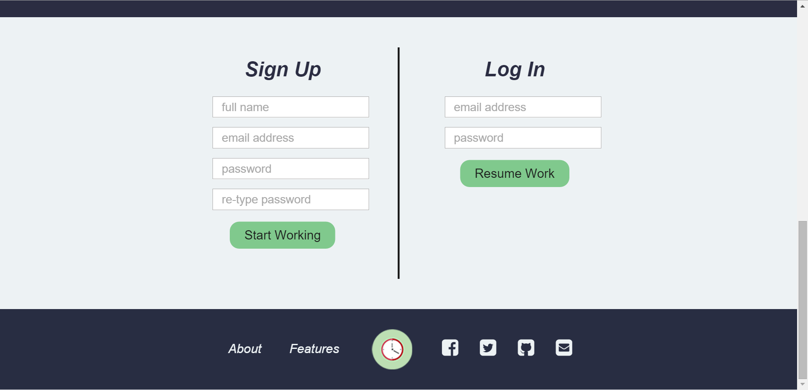
Login

Slide 8
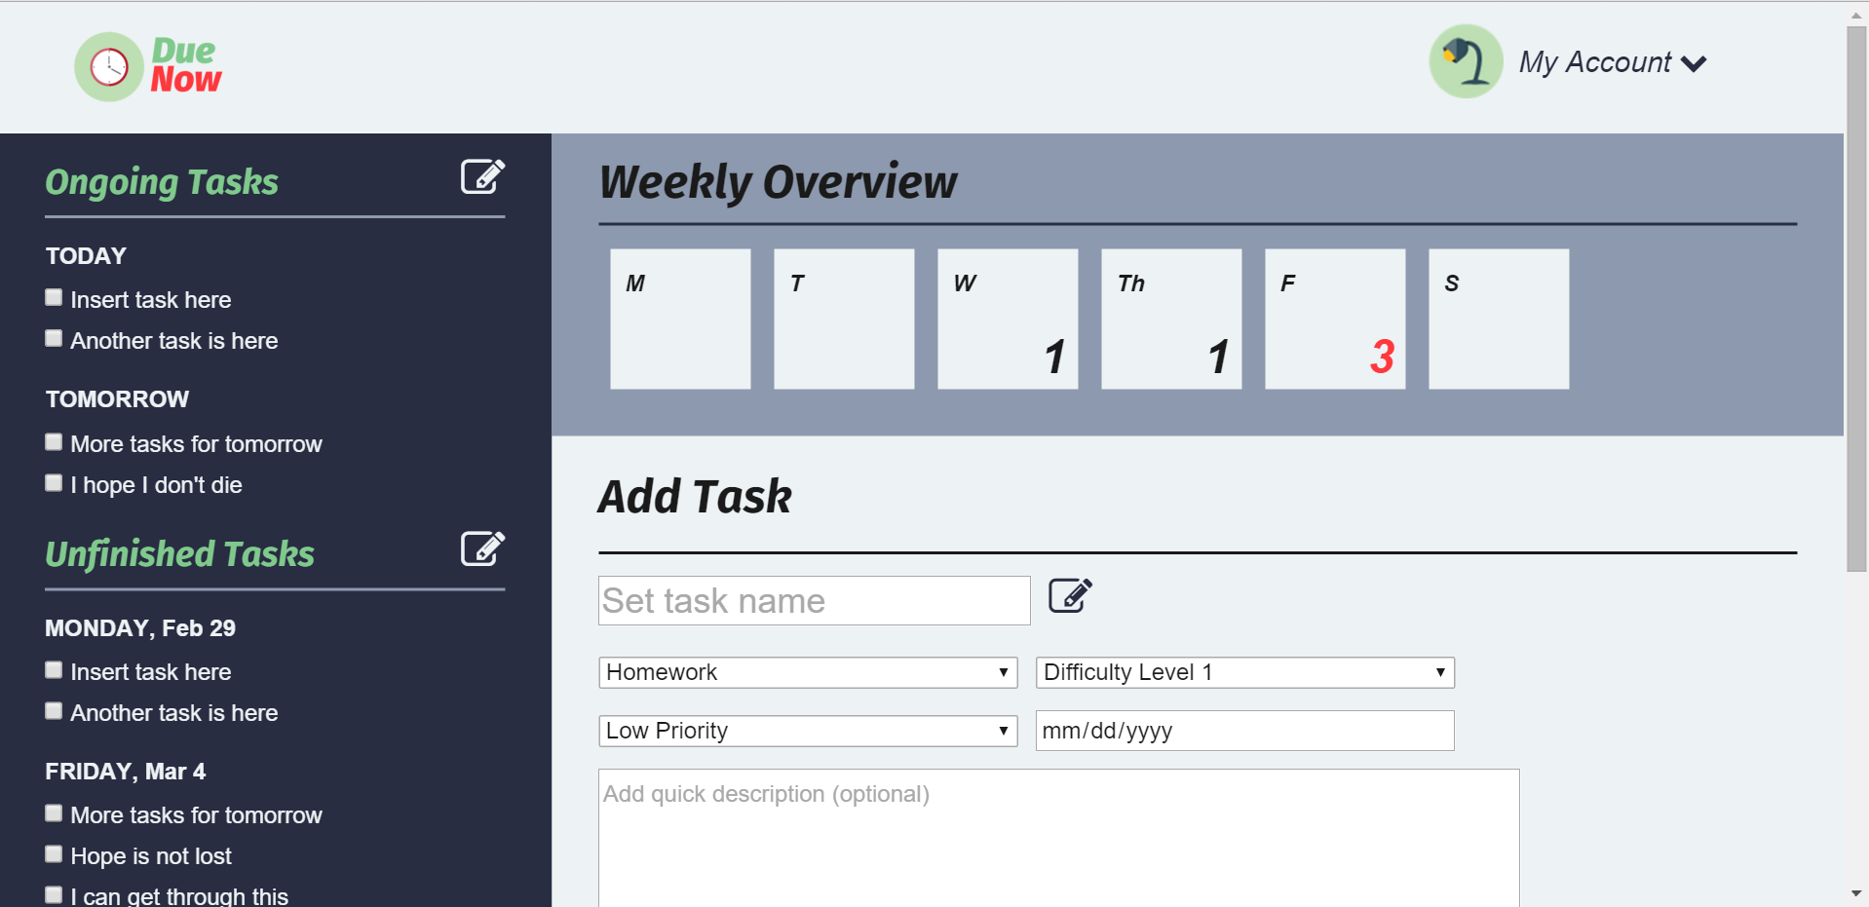
Scheduling Tasks

Slide 9
What makes Due Now different from other scheduling applications?

Slide 10
Questions?

Slide 11
Thank you!

